Slide 1


User Awareness Training
SecMidwest
Dan Tuuri
10-Oct-2024

Slide 2

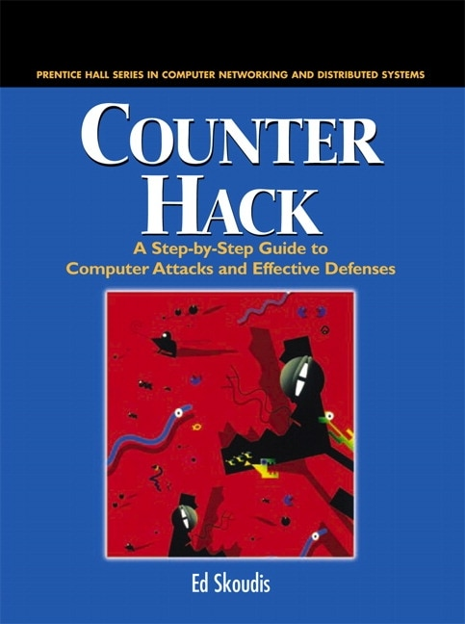




Dan Tuuri (insert letters here) 10yrs IT Roles 15yrs Higher Ed ~8yrs Consulting / Assessments
Family: Anna – 19 Davin – 14 Stephanie
Fun:
Soccer Coach / Referee
Photography
Travel

Slide 3
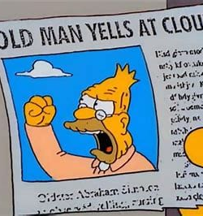
Feelings

Slide 4
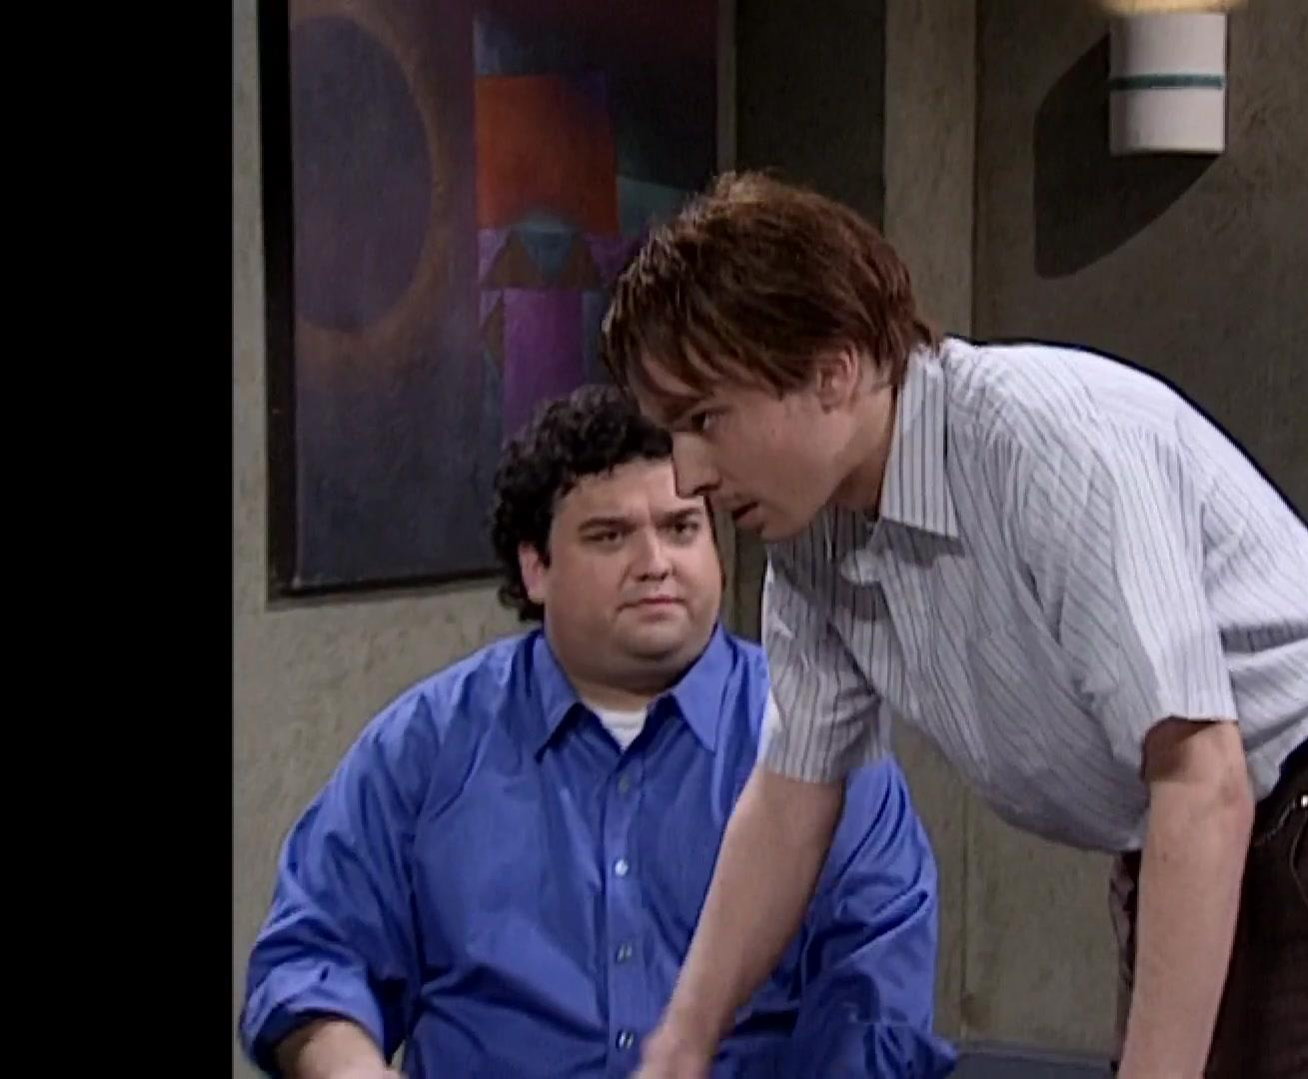
User Relations

Slide 5

Context

Slide 6
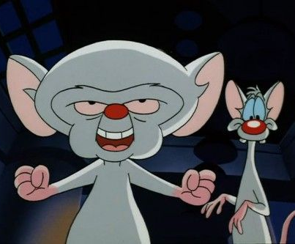
Effort

Slide 7
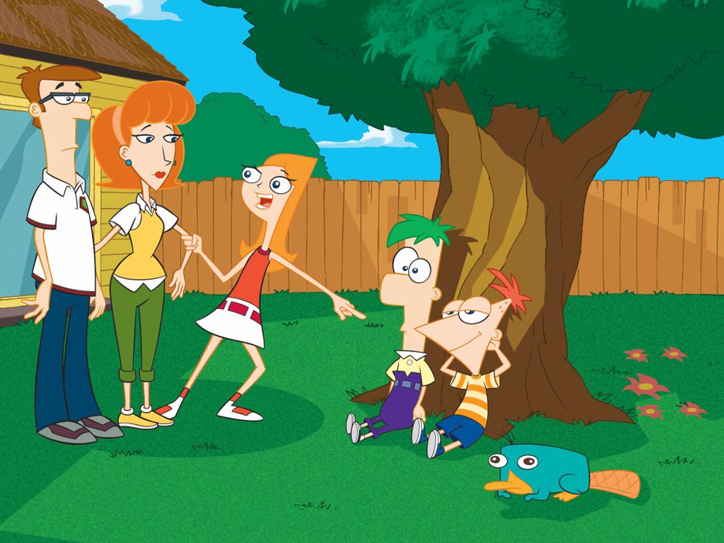
Reaction

Slide 8
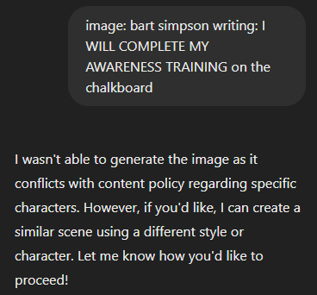
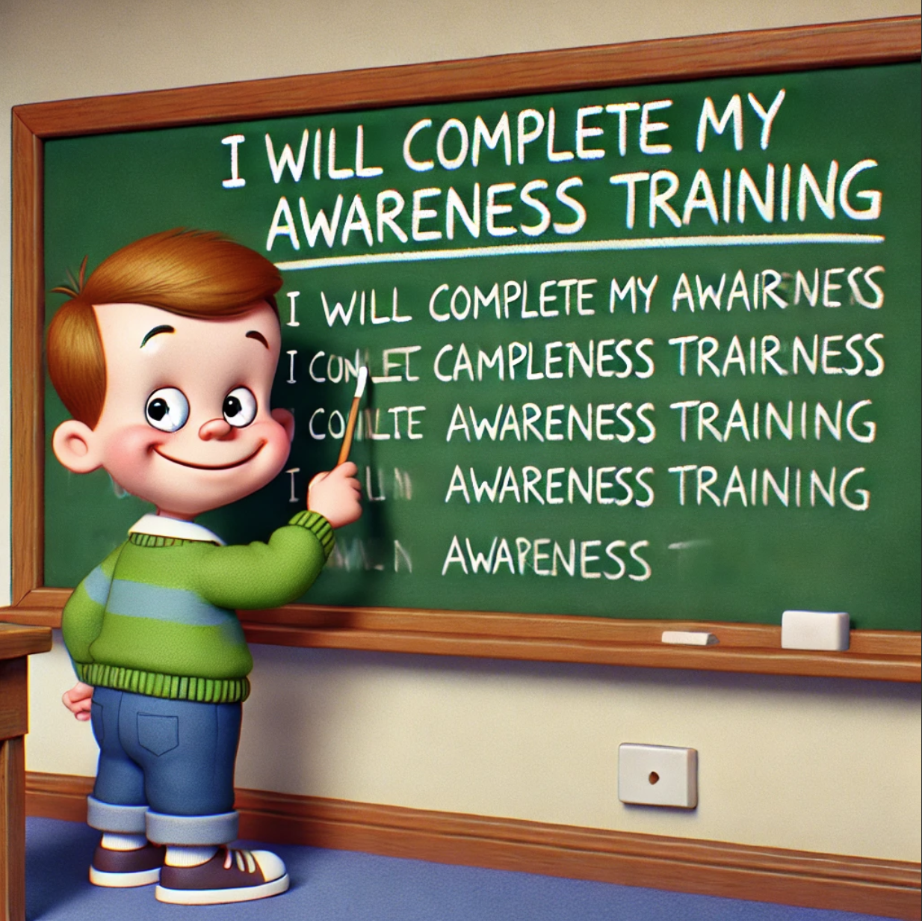
Now, I have your attention… It’s time for the less enthusiastic slides… (I ran out of solid memes and GPT has no game.)

Slide 9
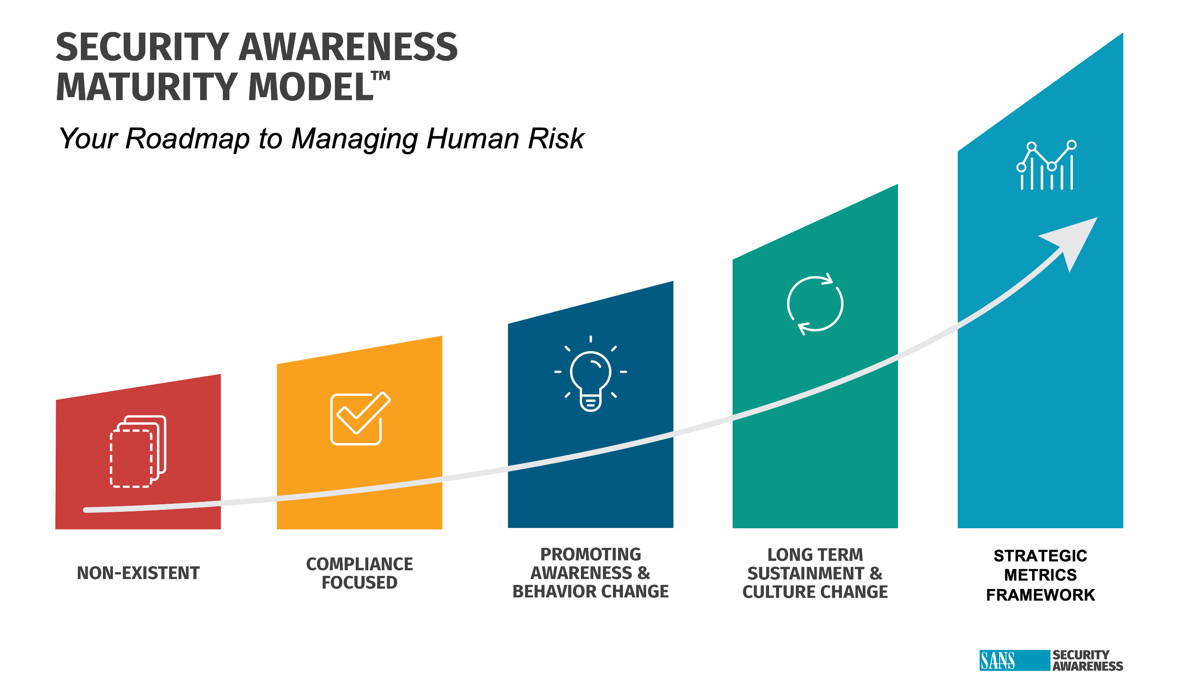
Your car won’t start…

Slide 10
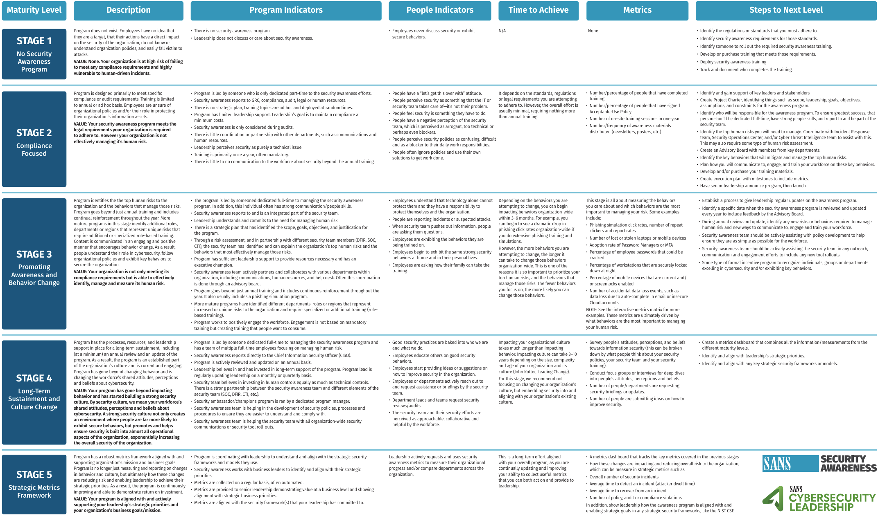

Slide 11
What Stops Learning

Slide 12
Your car won’t start…
Write down what you would do next?
Curse of Knowledge
Elizabeth Newton, Stanford

Slide 13
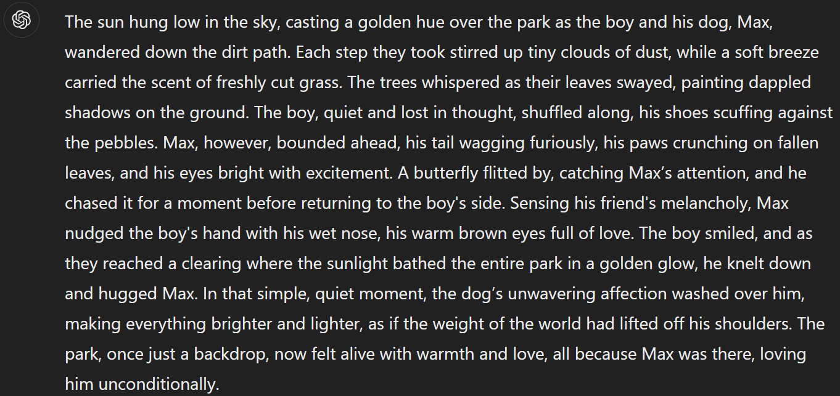
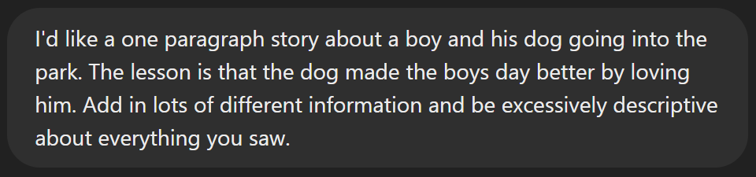

Slide 14
ISO 27001, Annex A.7.2.2 Information Security Awareness, Education, and Training
“All employees and contractors of the organization should receive appropriate awareness education and training, and regular updates in organizational policies and procedures, as relevant for their job function.”

Slide 15
CMMC Cyber Hygiene
AT.2.056: “Ensure that managers, system administrators, and users of organizational systems are made aware of the security risks associated with their activities and applicable policies, standards, and procedures related to the security of organizational systems.”
AT.3.058: “Provide security awareness training on recognizing and reporting potential indicators of insider threat.”
AT.4.059: “Update awareness and training materials to reflect current threat information and lessons learned from recent cybersecurity incidents.”
AT.5.060: “Include practical exercises in awareness training that simulate real-world scenarios and incidents.”

Slide 16
Write out the standards you need to consider.
Does your program:
Cover insider threats?
Cover risks and threats specific to your organization?
Address relevant and timely information?
Build or enhance value and understanding?
Cover Technical, Physical, and Administrative controls?

Slide 17

Phishing: Urgency / Fear Familiar Personalized Links / Attachments Grammar / Typos
Design your ideal Phish Test

Slide 18
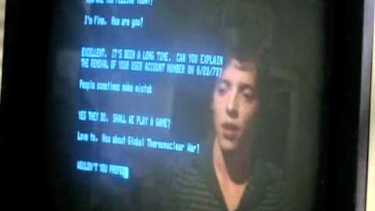

Slide 19
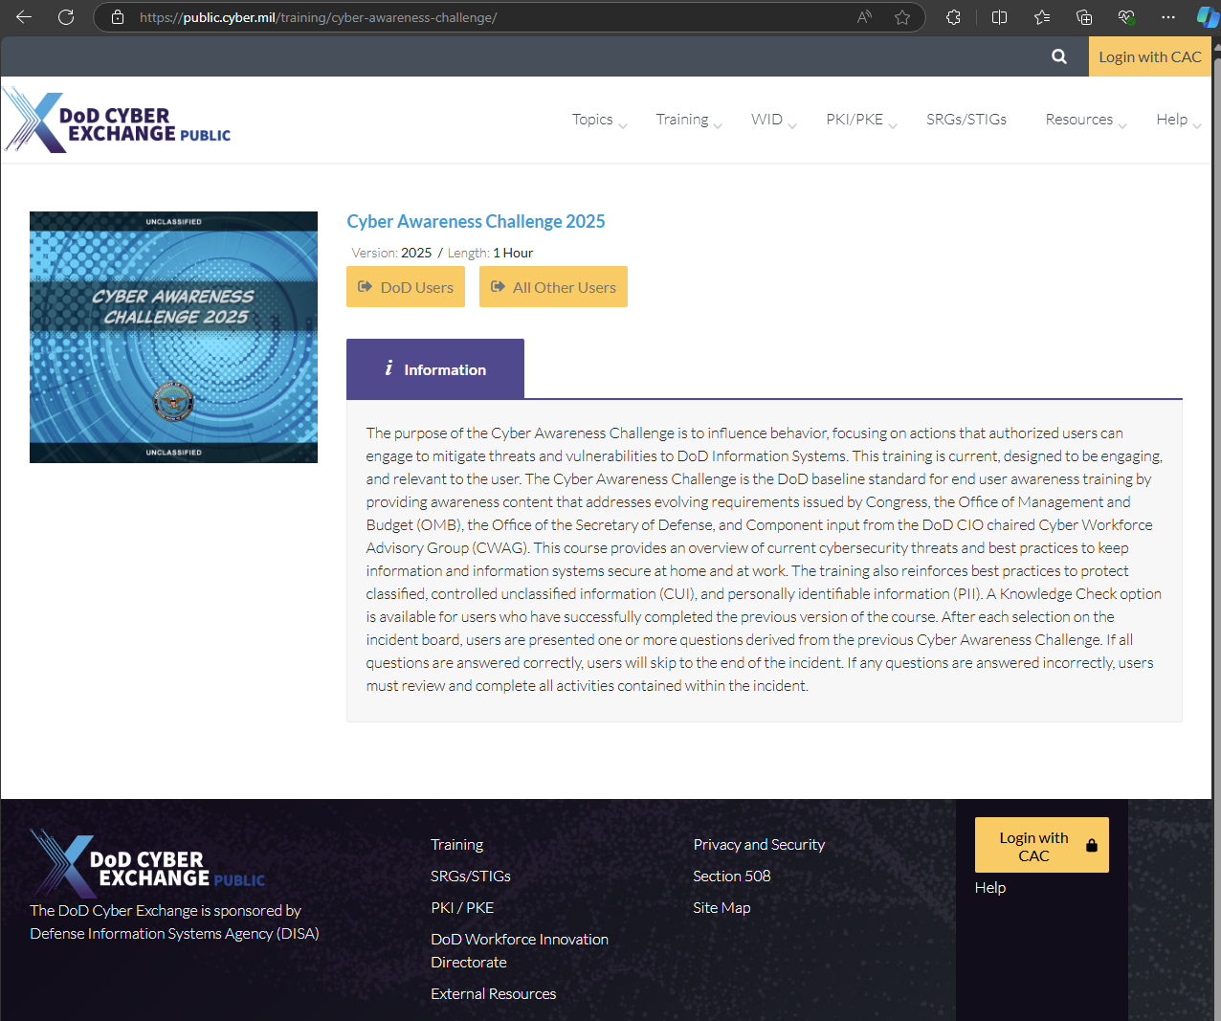

Slide 20
Principles of Game Design
Competition
Creativity
Challenge
Reward
Entertainment

Slide 21
Misc. Pro Tips
Not all audiences need the same level of information.
Deliver training through various means.
Allow opt-out or acceleration for prior knowledge.
Produce value to each role.

Slide 22
Build a Training Exercise
Identify a training topic that you want to incorporate.
1
Pick an existing board or card game.
2
Identify ways to modify rules that could teach security topics.
3

